Slide 1
Movie Recommender System
Presented by:
Sahand Malek
Soroush Salehi
Hossein Zinaghaji

Slide 2
Introduction
Recommender Systems are a subset of Information Filtering Systems. The purpose of recommender systems is to offer users the most relevant items (data, merchandise, entertainment, and more).

Slide 3
Problem Formulation
Recommendation systems can be used in a variety of areas. These systems are used to generate Playlists on movie and music services such as Netflix and YouTube.

Slide 4
Recommendation Approaches
Content-Based approach:In some recommender systems, content-based refinement may be used, which offers suggestions based on the user's past choices. Moreover, content-based refinement offers suggestions using the content of the objects intended for bid. Therefore, certain content may be analyzed
Collaborative approach:In Collaborative item-based recommender systems, recommendations for a particular user are predicted based on items previously rated by similar users.
Hybrid Approach:It is a combination of previous methods that have tried to take advantage of those methods by combining them and cover their limitations.

Slide 5
Data Description and Data Sources
The data are contained in the following files.
credits.csv
keywords.csv
links.csv
links_small.csv
movies_metadata.csv
ratings.csv
ratings_small.csv
Users were selected at random for inclusion. All selected users had rated at least 20 movies. No demographic information is included. An id represents each user, and no other information is provided.

Slide 6


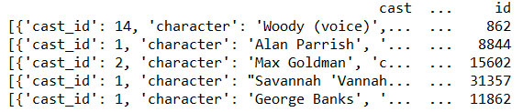
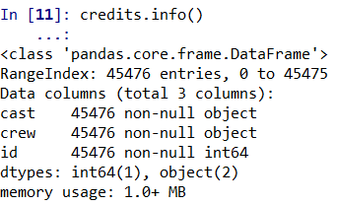

Data Visualization
Credits:

Slide 7
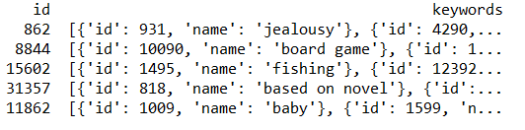

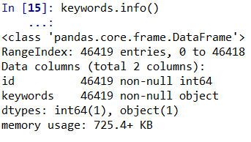

Data Visualization
Keywords

Slide 8

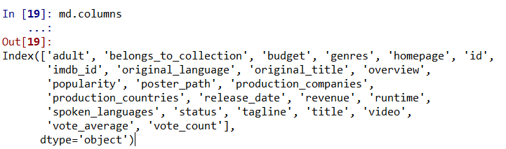
Data Visualization
Movie Metadata

Slide 9

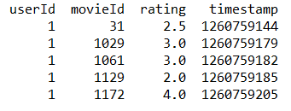

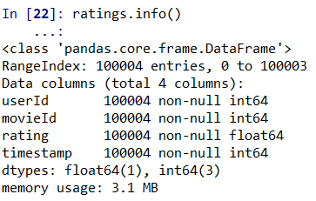
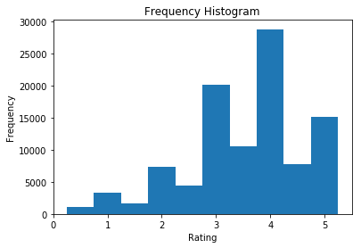
Data Visualization
Rating

Slide 10
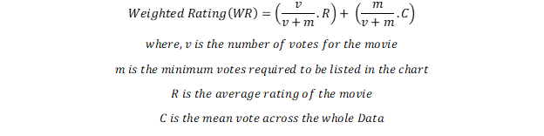
Build recommendation system:
The Simple Recommender offers generalized recommendations to every user based on movie popularity and (sometimes) genre.
The basic idea behind this recommender is that movies that are more popular and more critically acclaimed will have a higher probability of being liked by the average audience.
This model does not give personalized recommendations based on the user.
Simple recommendation system

Slide 11
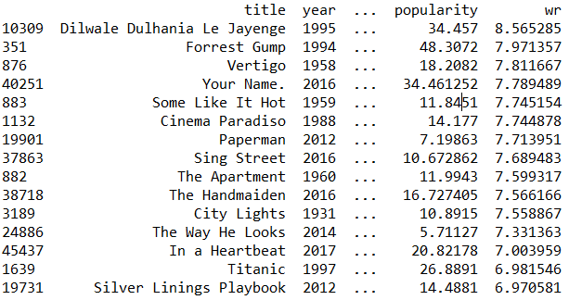
Simple Recommendation system results:
build_chart('Romance').head(15):

Slide 12
Content based recommendation system
Content based RS : Using movie description, taglines, keywords, cast, director and genres
we have used the TF-IDF Vectorizer,
calculating the Dot Product will directly give us the Cosine Similarity Score
To build our standard metadata-based content recommender, we will need to merge our current dataset with the crew and the keyword datasets.
1. Crew:
2. Cast:
We used a Count Vectorizer to create our count matrix consists of genres, director, main actors and keyword
We will do a small amount of pre-processing of our keywords before putting them to any use.
In this recommendation system we used Cosine Similarity which is a measure of the similarity between two nonzero vectors. Using this formula, we can find the similarity between two documents d1 and d2:

Slide 13
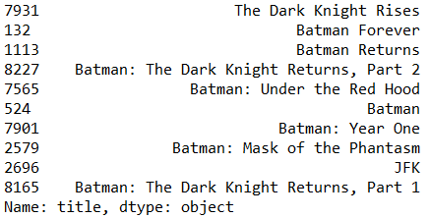
Content based RS: Using movie description and taglines Results
get_recommendations('The Dark Knight').head(10)

Slide 14
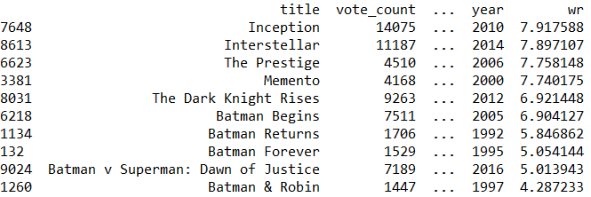
Content based RS : Using movie description, taglines, keywords, cast, director and genres Results
improved_recommendations('The Dark Knight')

Slide 15
Evaluation of Content based RS
We see that for The Dark Knight, our system is able to identify it as a Batman film and subsequently recommend other Batman films as its top recommendations.
But unfortunately, that is all this system can do at the moment.
This is not of much use to most people as it doesn't take into considerations very important features such as cast, crew, director and genre, which determine the rating and the popularity of a movie.
We do not have a quantitative metric to judge our machine's performance so this will have to be done qualitatively.

Slide 16
Evaluation of Content based RS
Improvement
We can of course experiment on this engine by trying out different weights for our features (directors, actors, genres), limiting the number of keywords that can be used in the soup, weighing genres based on their frequency, only showing movies with the same languages, etc.
We are much more satisfied with the results I get this time around. The recommendations seem to have recognized other Christopher Nolan movies (due to the high weightage given to director) and put them as top recommendations.
I personally enjoyed watching The Dark Knight as well as some of the other ones in the list including Batman Begins, The Prestige and The Dark Knight Rises.

Slide 17

CF based recommendation system
Limitation
It is only capable of suggesting movies which are close to a certain movie. That is, it is not capable of capturing tastes and providing recommendations across genres.
Also, the engine that we built is not really personal in that it doesn't capture the personal tastes and biases of a user. Anyone querying our engine for recommendations based on a movie will receive the same recommendations for that movie, regardless of who (s)he is.

Slide 18
CF based recommendation system
We have used several algorithms from surprise library to make our CF based recommendation system:
SVD
NMF
KNN
KNN With Means

Slide 19
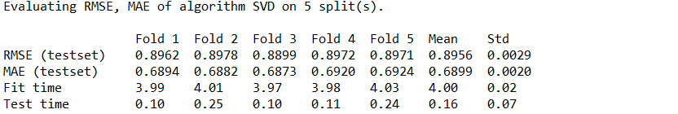
SVD results:
SVD prediction for user 13 The Dark Knight’s rating: 3.55

Slide 20
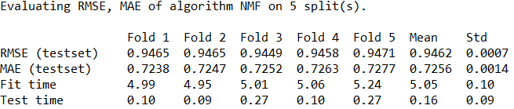
NMF Results
NMF prediction for user 13 The Dark Knight’s rating: 3.51

Slide 21

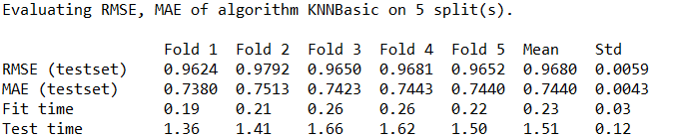
KNN Results
KNN prediction for user 13 The Dark Knight’s rating: 4.24

Slide 22
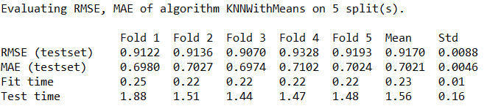
KNN Means Results
KNNMeans prediction for user 13 The Dark Knight’s rating: 4.14

Slide 23
Hybrid Recommendation System
In this section, will try to build a simple hybrid recommender that brings together techniques we have implemented in the content based and collaborative filter-based engines. This is how it will work:
Input:
Output:
We Choose the best algorithm from CF based recommendation -> KNNBasic

Slide 24
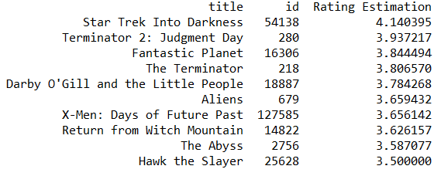
Hybrid Recommendation System Result
hybrid(1, 'Avatar'):

Slide 25
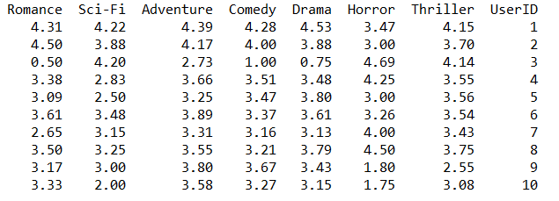
Clustering
We also Used clustering method. To Recommend movies to our users, We clustered them based on their average rating to different genres.

Slide 26
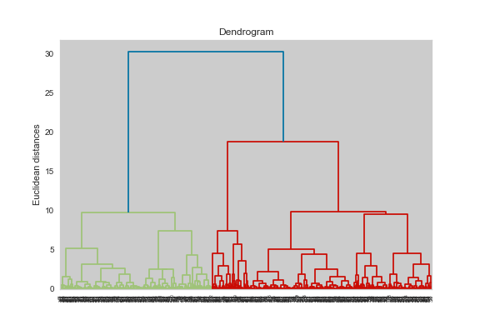
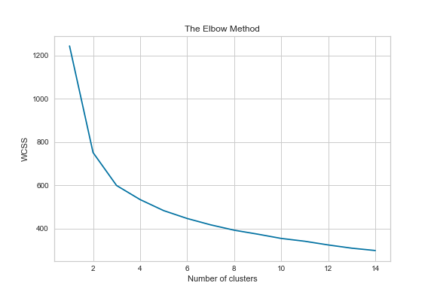
Clustering
Number of clusters:

Slide 27
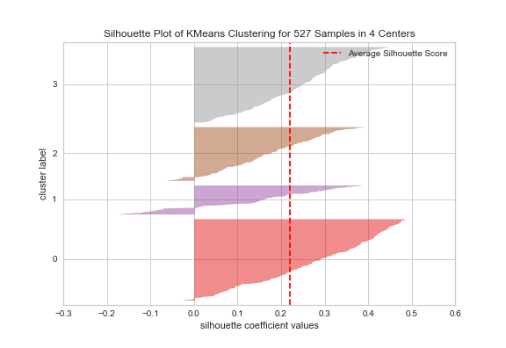
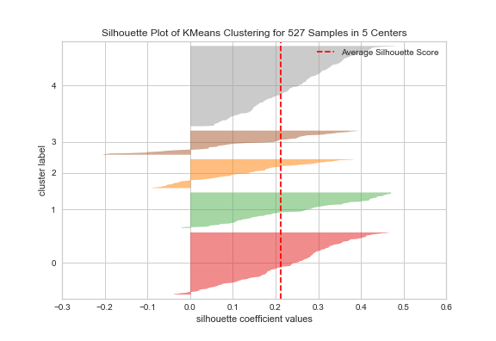
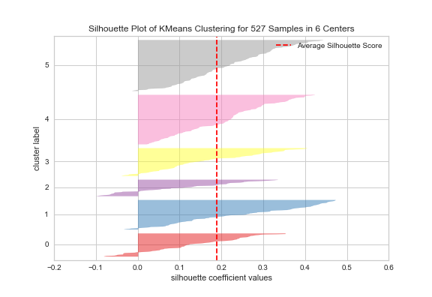
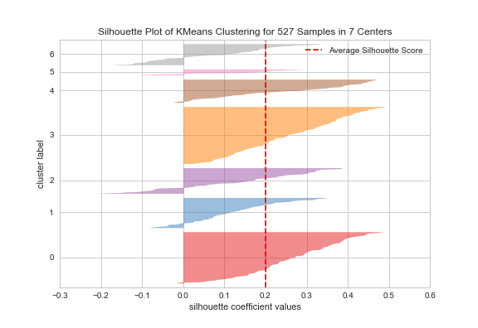
Number of clusters:

Slide 28
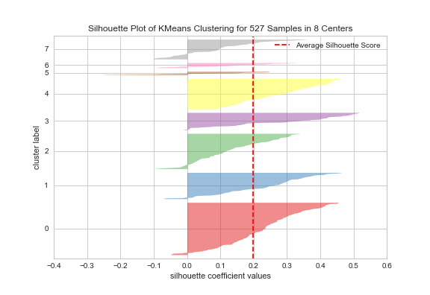
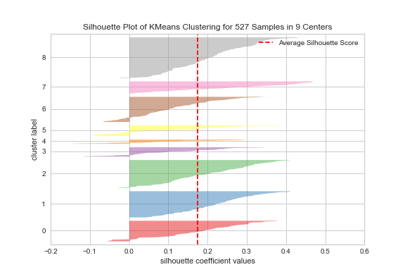
Number of clusters:

Slide 29
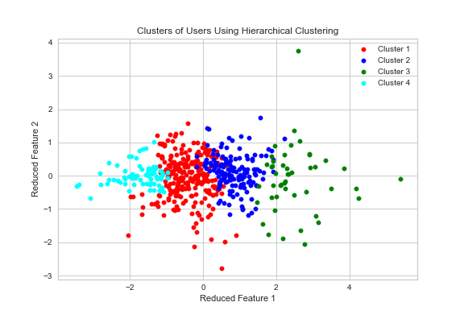
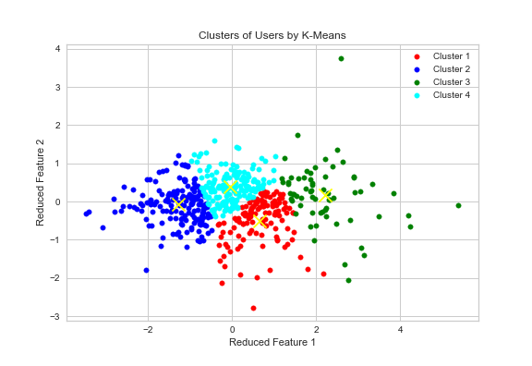
Clustering result:

Slide 30
THANK YOU

